Slide 1

How to Throw Dice in 4D Space - without dropping your phone
Georgi Chunev
(georgi.chunev@gameloft.com)
Gameloft - Bulgaria

Slide 2
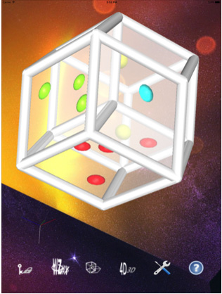
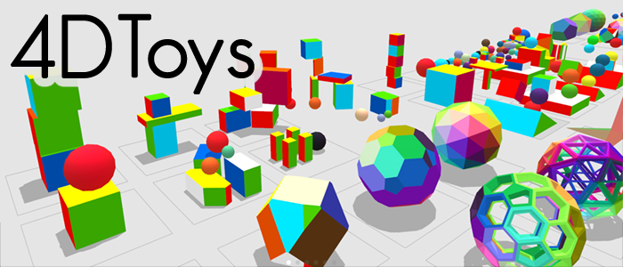
What Motivated the Project
Old experience with 4D ray tracing
I once attempted an OpenCL port of a ray-traced version of GL4D - a 4D manifold visualization library
Interest in designing a game in 4D
Andrew Hanson's 4Dice app
Lacks the physics for throwing the die
Marc ten Bosch's projects
Has a proprietary (and very secretive) 4D physics engine
Supports only viewing 3D slices from 4D space
4Dice
https://www.cs.indiana.edu/~hanson/
http://4dtoys.com/

Slide 3
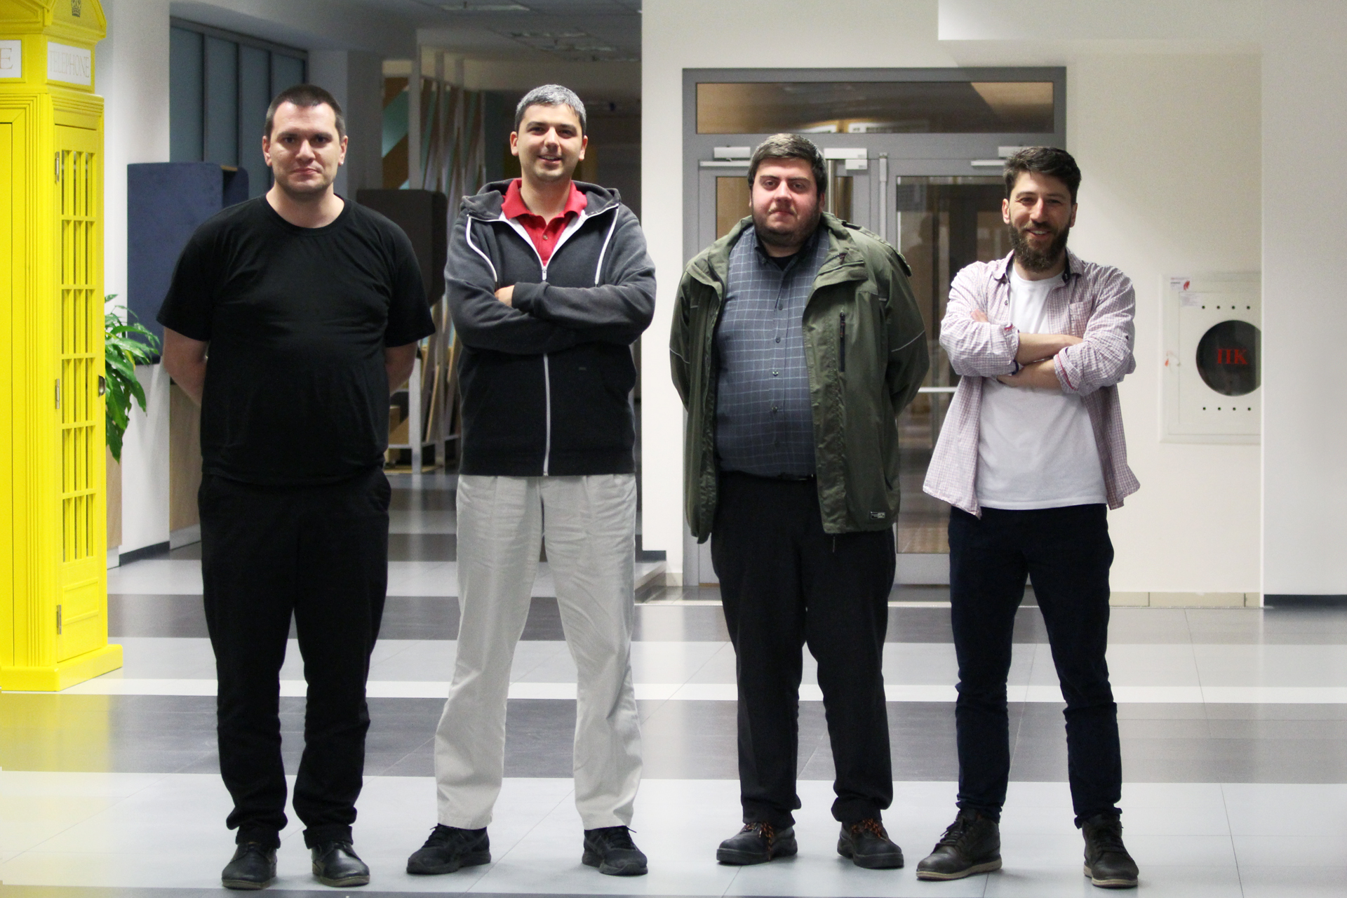
The Team at Gameloft
Georgi Chunev - studio lead graphics programmer and holding ABD in computer science
Dimitar Kodjabachev - senior programmer and math PhD
Nikolay Dimitrov - studio technical director
Vladislav Ivanov - programmer and holding an MS in physics
We'll take your brain to another dimension.
Pay close attention!

Slide 4
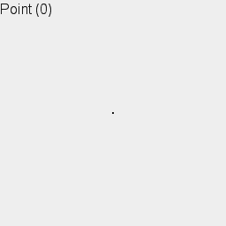
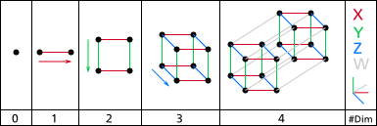
4D Euclidean Space
A point is described by four coordinates (x,y,z,w), representing displacement along four orthogonal directions (X,Y,Z,W).
By limiting the extent of the space to a fixed length along each axis you get an n-cube.
https://en.wikipedia.org/wiki/Hypercube
Note: Also, look at Hanson's 4Dice to get a better intuition for hypercubes and 4D space
https://itunes.apple.com/us/app/4dice/id453083422?mt=8

Slide 5
Graphics Primitives in 4D

Slide 6
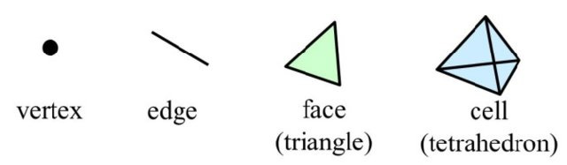

Polygonal Primitives
Polygonal models in 4D can be constructed out of tetrahedra (3-simplex).
This is analogous to using triangles for 3D surfaces.
Supporting rectangular cells or parallelepipeds can be beneficial as you require at least 5 tetrahedra to represent such cells.
This is analogous to using quads.
Side note: for an unsolved math problem see https://oeis.org/A019503
For the die implementation we needed only hypercubes / tesseracts.

Slide 7
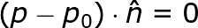

Implicit Geometry
Higher-dimensional meshes take up a lot of space to store.
With ray-tracing we can make use of implicitly defined primitives to save space (https://en.wikipedia.org/wiki/Implicit_surface). Often, the equation that describes a given primitive applies independently of dimensionality:
(Hyper)planes:
Spheres:

Slide 8
Texturing in 4D
Higher-dimensional textures take up a prohibitive amount of space to store.
Where texturing is needed consider using procedural textures.
For our die faces, we use a set of easy to sample radial volumetric functions (more on this later).
Note that 4D surfaces require 3D textures, which, at some point in the rendering pipeline, need to effectively pass through a volume renderer.

Slide 9
Viewing the 4th Dimension

Slide 10
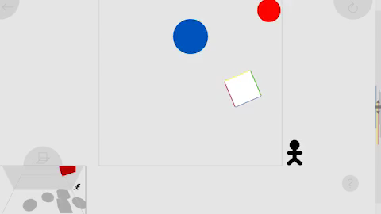
Rendering 3D Slices
Marc ten Bosch's 4D Toys uses slices. With this approach you take a 3D planar slice from 4D space and render the resulting 3D objects using standard techniques. This approach is problematic when trying to observe jumping and rolling objects, as is the case with our die.
https://thumbs.gfycat.com/FalseFarflungAphid-mobile.mp4

Slide 11
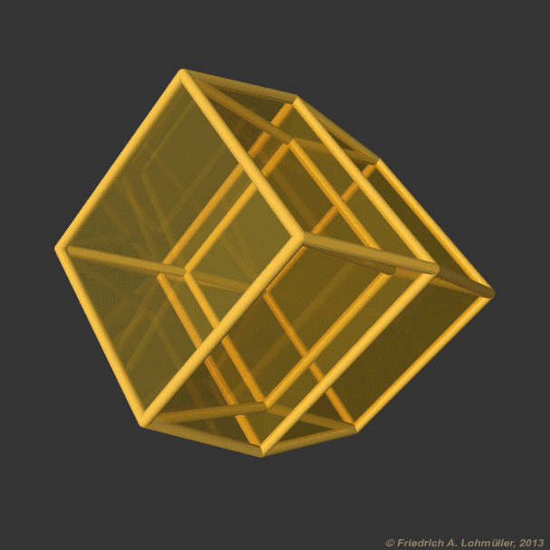
Wireframe Rendition of 4D Projection
Hanson’s 4Dice uses this approach. It is very well suited for watching how the whole die rolls, but needs to be extended to show the individual sides.

Slide 12
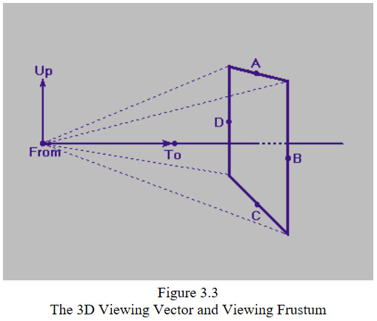
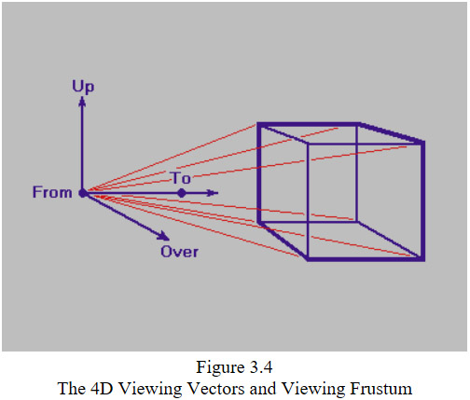
4D Ray Tracing
For a brief discussion of the basic math see Hanson et al. “Geometry for N-Dimensional Graphics”. The involved techniques hardly differ from their 3D counterparts, with the main difference being that you will be projecting down to 3D – i.e. your virtual retina is a volume!
https://hollasch.github.io/ray4/Four-Space_Visualization_of_4D_Objects.html

Slide 13
Our Approach
Volume ray caster with a single proxy plane:
4D Ray from Voxel along 4D to 3D Projection Direction
For each volumetric cell in the scene:
Generate a view-space, axis-aligned proxy quad behind the volume and covering the volume's full screen-space projection
For each fragment of the rasterized proxy quad march a ray towards the camera
For each voxel, unproject to 4D world-space and shoot a ray to sample the rendered cell along the 4D to 3D projection direction
Accumulate sampled radiance
End the 3D ray marching when you reach the closest depth of the volume to the camera
View-space Proxy Quad
Camera
Ray-Marched Volume

Slide 14
Our Approach (continued)
We use an axis-aligned orthographic projection from 4D world space to 3D world space. The transformation is stored as an invertible frame matrix.
float curDepth = rayMarchingStart;
for (curDepth = rayMarchingStart; curDepth >= rayMarchingEnd; curDepth += rayMarchingStep)
{
// Move from View-space to World-space:
vec3 position = vsPosition * curDepth / vsPosition.z;
vec3 wsPosition3D = vec3(View_Matrix_Inv * vec4(position, 1.0));
vec4 wsPosition = ProjectorFrame_Matrix_Inv * vec4(wsPosition3D, cellPosition.w);
vec4 projViewDir = ProjectorFrame_Matrix_Inv[3];
// 4D Ray cast:
float t = intersectPlaneDoubleSided(cellNormal, cellPosition, wsPosition, projViewDir);
vec4 p = wsPosition + projViewDir * t;
}

Slide 15
Physics in 4D

Slide 16
Box 2D Lite
We started our code base from Erin Catto's GDC 2009 demo - Box2D Lite available here: https://box2d.org/downloads/
The Box2D Lite code is largely based on: “An Introduction to Physically Based Modeling: Rigid Body Simulation II—Nonpenetration Constraints” - a SIGGRAPH 1997 course by David Baraff.
Each box object is a rigid body with all transformations applied to its center of mass. Collision resolution is implemented via an iterative application of corrective impulses (instead of forces) for each detected contact point.

Slide 17
Dice3D
Our next step was to port Box2D Lite to 3D
We simplified the collision detection, since we needed to support only collisions between a rolling die and a set of walls (planes).
We also changed our models for the dynamics of the die:
Moving to 4D required yet another set of generalizations
Parameter | 2D | 3D
position | vec2 | vec3
velocity | vec2 | vec3
orientation | float (angle) | mat3 (axis - angle)
angular velocity | float | vec3 (result from applied torques)

Slide 18
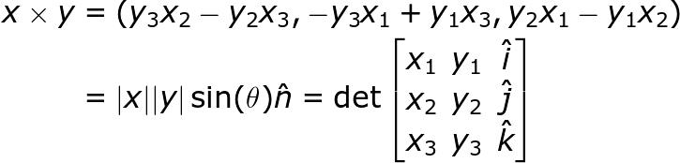
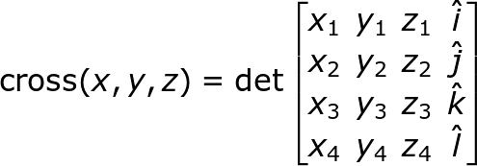
Generalized Cross Product
3D Cross product:
A binary operator
Gives an orthogonal vector to the inputs
The result maps to torque in 3D
Cross product generalization (type 1):
Hanson et al. “Geometry for N-Dimensional Graphics” discusses the more standard generalization, which is an operator of N-1 N-dimensional vectors and produces a new N-dimensional vector orthogonal to all of the starting vectors. The approach is great for obtaining normals, but can not be used to compute torques. In 4D we have:

Slide 19
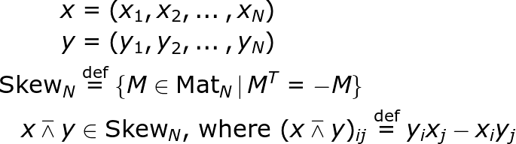
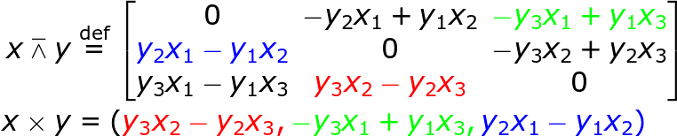
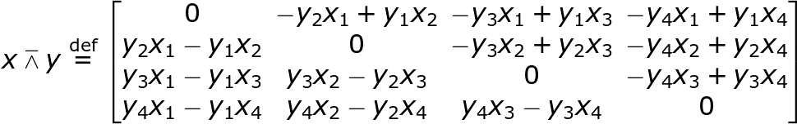
Generalized Cross Product (continued)
Cross product generalization (type 2):
Gonano et al. “Cross Product in N-Dimensions – the Doublewedge Product” present a binary operator generalization of the cross product, which produces a tensor suitable for implementing torques in higher dimensions:
ND Case:
3D Case:
4D Case:

Slide 20
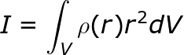
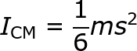
Rotational Inertia in 4D
For lower dimensions you can find lists with the moments of inertia for different standard shapes: https://en.wikipedia.org/wiki/List_of_moments_of_inertia
For higher dimensions you might have to compute the moment of inertia from the definition:
Fortunately, when rotating about the center of mass a cube has constant moment of inertia and the formula is the same regardless of dimension:

Slide 21
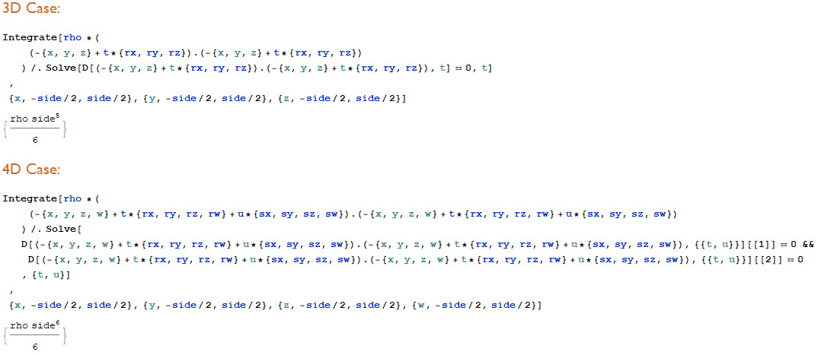
Rotational Inertia For a Cube

Slide 22
Angular Velocity in 4D
Representation:
Application:
Compute corrective impulses for each contact point and apply the correction to center of mass
Apply the net angular velocity using the Rodrigues formula:
Parameter | 3D | 4D
orientation | mat3 | mat4
angular velocity | vec3 or, equivalently, a skew-symmetric mat3 | vec6 or, equivalently, a skew-symmetric mat4
AccumulateAngularVelocity(DWedgeProduct(contactDistance, impulse / rotationalInertia))
orientation = RodriguesRotation(angularVelocity * dt) * orientation

Slide 23
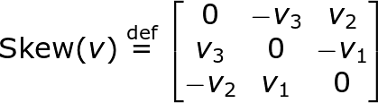
Arbitrary Rotations in 4D
Dimension | Rotation Model
2D | Angle:
3D | Axis-angle (Rodrigues' formula):
4D | A pair of axes-angles (generalized Rodrigues' formula): for the eigen decomposition:
Erdoğdu, M.; Özdemir, M. (2015). "Generating Four Dimensional Rotation Matrices".

Slide 24
Dice4D

Slide 25
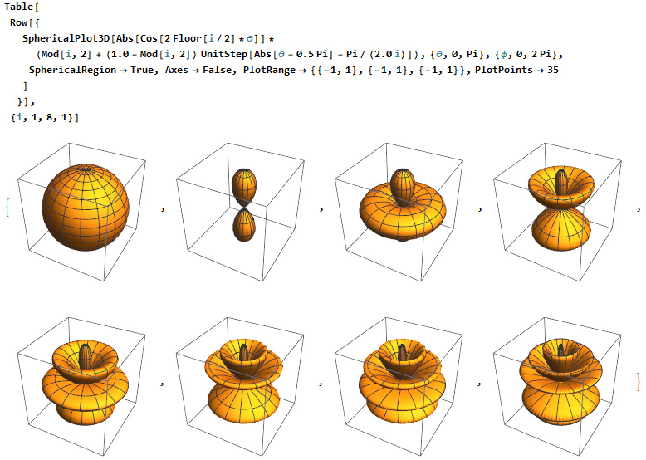
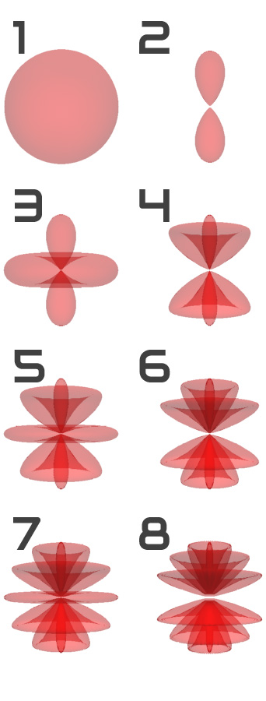
Our 4D Dice Labelling

Slide 26
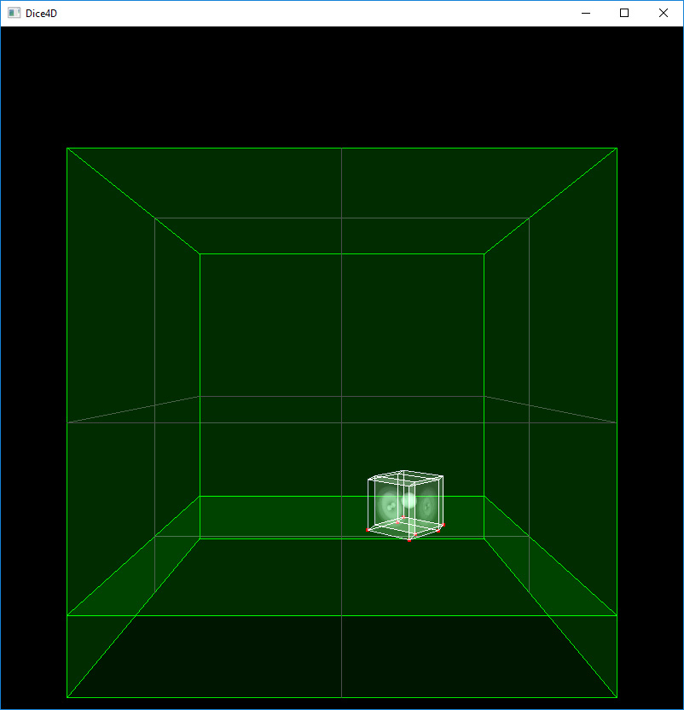
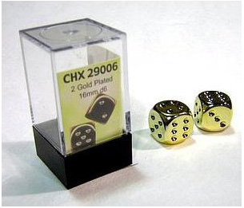
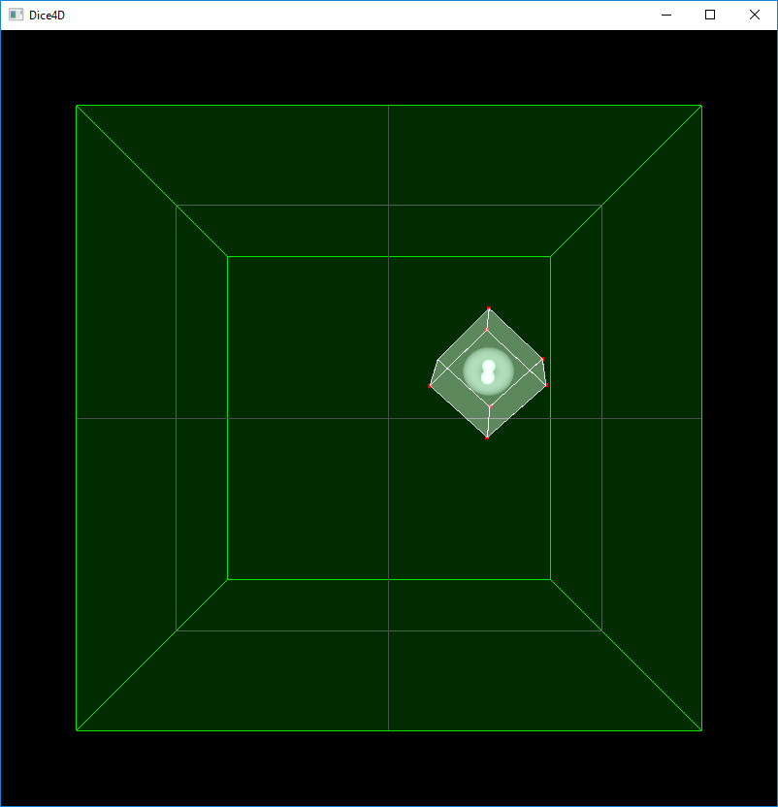
A Virtual 4D Dice Box (live demo)
A Dice Box
Side View
(4D -> X,Y,Z projection)
Top View
(4D -> X,Z,W projection)

Slide 27
Final Touches
Adding shaking and throwing
Using accelerometer data (sensor fusion on iOS) we directly mapped the 3D acceleration input to forces applied to the die and added some “imprecision” for large magnitude shakes that results in some shaking in the 4th dimension.
Adding sounds
The dimensionality of sound (mono, stereo, quadro) plays a small part in the audible experience relative to the actual sound being heard. This allows for a fairly accurate sound experience for sounds triggered by 4D objects.
Assessing die fairness - it is more complex than we expected: https://www.youtube.com/watch?v=G7zT9MljJ3Y

Slide 28
Thank You!!!

